Slide 1

Autonomous Trolly
(With Collision Avoidance Using LiDAR)

Slide 2
Problem Statement:
Manual trolleys are prone to human error, inefficiency, and collisions.
Need for a smart collision avoidance system that can detect and avoid obstacles in real-time. Designing a low-cost, sensor-based autonomous trolley with predefined path navigation and dynamic obstacle detection.
Introduction:
An autonomous trolley is a mobile robotic system designed to move along a predefined path without human intervention.
To ensure safety and obstacle avoidance, it uses LiDAR sensors for real-time environment sensing.
The goal is to automate material or goods transport efficiently and safely, especially in indoor or campus environments.

Slide 3

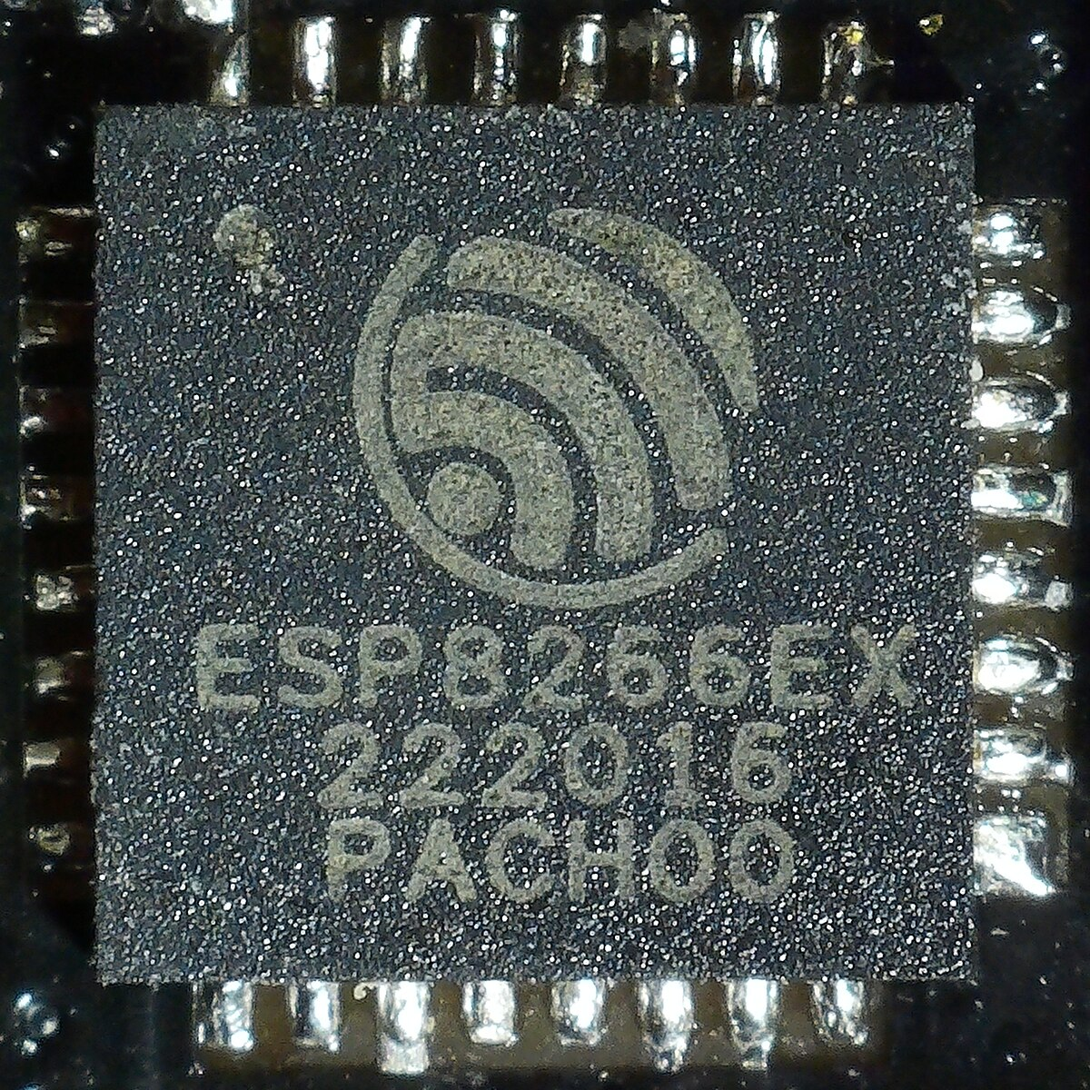


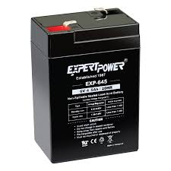
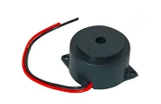
Components & Technologies:
Block Diagram:
Microcontroller:
Sensor: LiDAR (VL53L0X)
Motor Driver: L298N
Actuators: DC Motors
Programming Language:
Battery:
Buzzer:

Slide 4
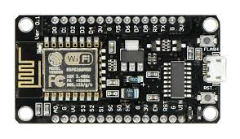
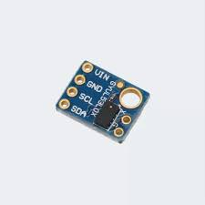
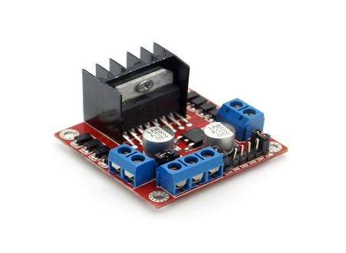
Microcontroller:
Microcontroller: ESP8266 (by Espressif Systems)
Main Feature: Built-in Wi-Fi – enables wireless data transmission to server/app
Processor: 32-bit Tensilica @ 80–160 MHz – handles lightweight control tasks
Operating Voltage: 3.3V – compatible with most sensors and logic devices
GPIOs: Up to 17 – for interfacing with sensors (LiDAR, IR, motor driver, etc.)
Memory: 32 KB RAM, up to 4 MB Flash – enough for basic control and data logging
Interfaces: UART (for LiDAR/Serial), I2C (sensors), PWM (for motors), ADC
Role in Project:
Collects LiDAR distance data
Sends obstacle info to central controller or server via Wi-Fi
Receives remote commands (start/stop/control)
Programming: Arduino IDE – simple integration with sensors and logic.
LiDAR Sensor:
Full Form: Light Detection and Ranging
Function: Measures distance to objects using laser light (usually infrared) and Provides real-time obstacle detection and mapping.
Working Principle: Emits laser pulses
Measures time taken for reflection to return
Calculates distance using Time-of-Flight (ToF) method
Output:
Provides precise distance data in cm/mm
Interfaces:
Communicates via UART, I2C, or PWM
Easily integrated with microcontrollers like ESP8266
Use in Project:
Detects obstacles in front of the trolley
Sends real-time distance data to ESP8266
Enables collision avoidance by controlling motor driver (L298N)
Motor Driver:
Function: Controls DC motors or stepper motors in both directions (forward/reverse)
Type: Dual H-Bridge Motor Driver IC
Voltage Range:
Motor supply: 5V–35V
Logic supply: 5V
Current: Up to 2A per channel
Channels: Controls 2 motors independently (left & right wheels of trolley)
Inputs:
Takes control signals from microcontroller (ESP8266/Arduino)
Uses IN1, IN2, IN3, IN4 for direction control
ENA & ENB enable/disable motors (can be PWM for speed control)
Use in Project:
Drives the trolley motors
Executes movement decisions based on LiDAR data
Supports directional control for obstacle avoidance

Slide 5
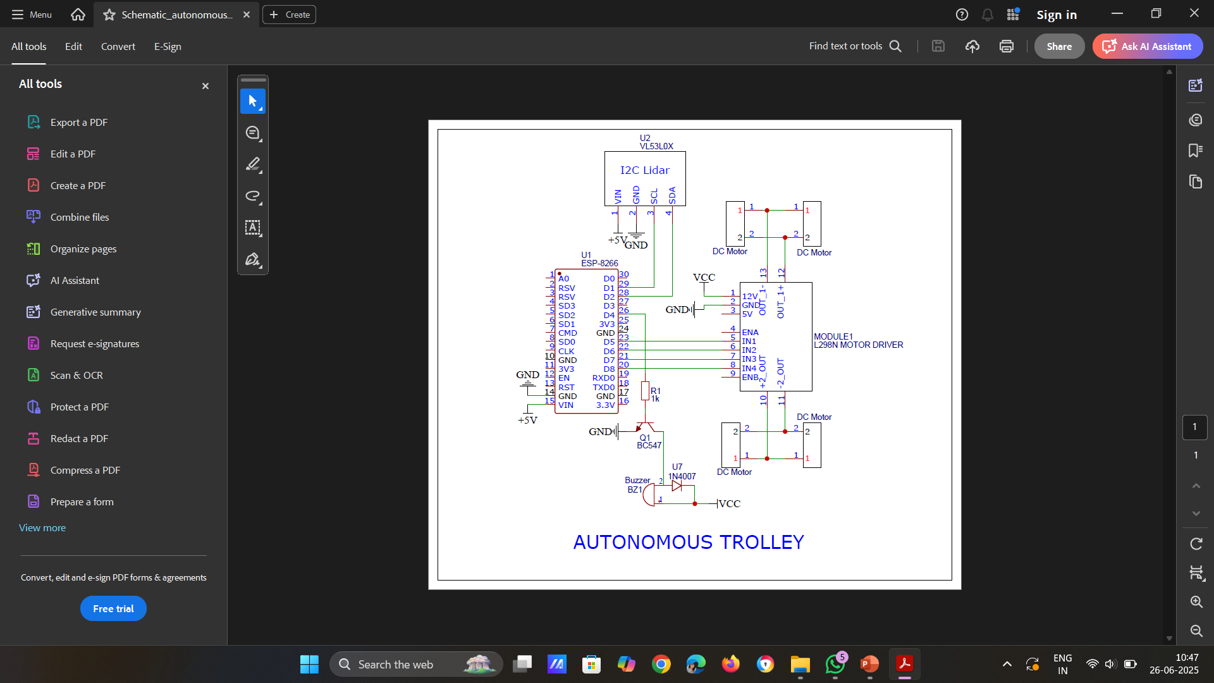
Circuit Diagram:

Slide 6
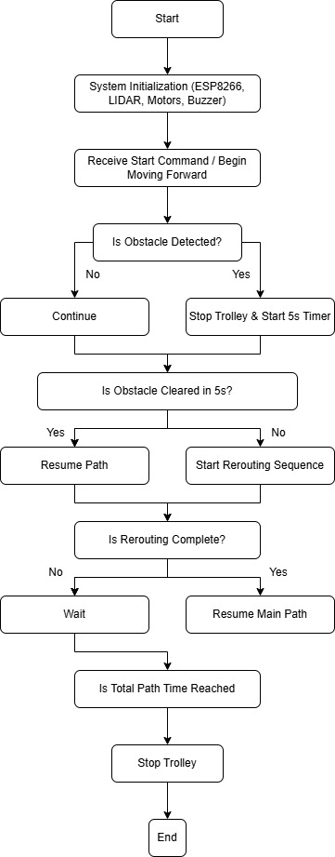
Flowchart and Working:

Slide 7
Challenges and Risks:
Strategies for overcoming these challenges:
Benefits:
Sensor interference in highly reflective environments
Battery drain with continuous operation
Limited path correction (due to predefined time-based movement)
Real-time accuracy under dynamic environments
Use multiple sensors (like IR or ultrasonic) for redundancy
Optimize power management
Use PID or encoder-based feedback for dynamic navigation
Future upgrade to SLAM-based navigation
Reduced human effort
Improved safety in narrow/crowded areas
Useful for campuses, warehouses, hospitals
Scalable and modular system
Eco-friendly and energy-efficient

Slide 8
Research And References:
Navigation Control Design of a Mobile Robot by Integrating Obstacle Avoidance and LiDAR SLAM
https://ieeexplore.ieee.org/document/8570517/
Published in: 2018 IEEE International Conference on Systems, Man, and Cybernetics (SMC)
3D LiDAR‑Based Lane Line Recognition and Obstacle Avoidance for Autonomous Mobile Robot
https://ieeexplore.ieee.org/document/10805213/
Published in: 2023 (IEEE Conference)
A Novel Algorithm for Autonomous Obstacle-Avoidance Based on LiDAR Data
https://ieeexplore.ieee.org/document/7419694/
Published in: 2015 IEEE Conference
LiDAR‑based Obstacle Avoidance for the Autonomous Mobile Robot
https://ieeexplore.ieee.org/document/8850952/
Published in: 2020 IEEE Conference
Finite Distribution Estimation‑Based Dynamic Window Approach to Reliable Obstacle Avoidance of Mobile Robot
https://ieeexplore.ieee.org/document/9428945/
Published in: 2021 IEEE Transactions on Industrial Electronics

